Slide 1
ECO102: Introduction to Macroeconomics
Lecturer: Addrita Shams
Week 02, Lecture 04
Chapter 22: Monitoring jobs and inflation

Slide 2
Price Level, Inflation and Deflation
A persistently rising price level is called inflation.
A persistently falling price level is called deflation.
Low, steady, and anticipated inflation or deflation isn’t a problem, but an unexpected burst of inflation or period of deflation brings big problems and costs.
An unexpected inflation or deflation:
■ Redistributes income
■ Redistributes wealth
■ Lowers real GDP and employment
■ Diverts resources from production

Slide 3
Why Inflation is a problem:
Redistribution of Income: An unexpected burst of inflation raises prices but doesn’t immediately raise the wages. Workers are worse off because their wages buy less than they bargained for and employers are better off because their profits rise.
Redistribution of Wealth: With an unexpected burst of inflation the money that the borrower repays to the lender buys less than the money originally loaned. The borrower wins and the lender loses. The interest paid on the loan doesn’t compensate the lender for the loss in the value of the money loaned.

Slide 4
Why Inflation is a problem (Contd.)
Lowers Real GDP and Employment Unexpected inflation that raises firms’ profits brings a rise in investment and a boom in production and employment. Real GDP rises above potential GDP and the unemployment rate falls below the natural rate. But this situation is temporary. Profitable investment dries up, spending falls, real GDP falls below potential GDP and the unemployment rate rises. Avoiding these swings in production and jobs means avoiding unexpected swings in the inflation rate.
Diverts Resources from Production: It can become more profitable to forecast the inflation rate or deflation rate correctly than to invent a new product. Doctors, lawyers, accountants, farmers—just about everyone—can make themselves better off, not by specializing in the profession for which they have been trained but by spending more of their time dabbling as amateur economists and inflation forecasters and managing their investments.

Slide 5
Consumer Price Index
Every month, the Bureau of Labor Statistics (BLS) measures the price level by calculating the Consumer Price Index (CPI), which is a measure of the average of the prices paid by urban consumers for a fixed basket of consumer goods and services.
Constructing the CPI involves three stages:
■ Selecting the CPI basket
■ Conducting the monthly price survey
■ Calculating the CPI

Slide 6
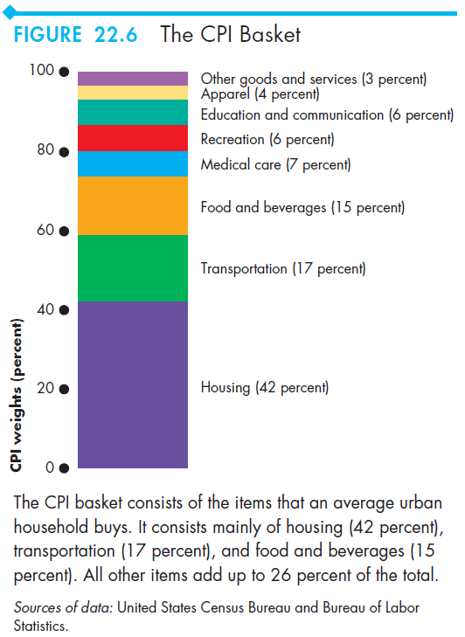
Stage 1 and 2:
Selecting the CPI Basket: This basket contains the goods and services represented in the index, each weighted by its relative importance. The idea is to make the relative importance of the items in the CPI basket the same as that in the budget of an average urban household
Monthly Price Survey: Because the CPI aims to measure price changes, it is important that the prices recorded each month refer to exactly the same item.
Once the raw price data are in hand, the next task is to calculate the CPI.

Slide 7
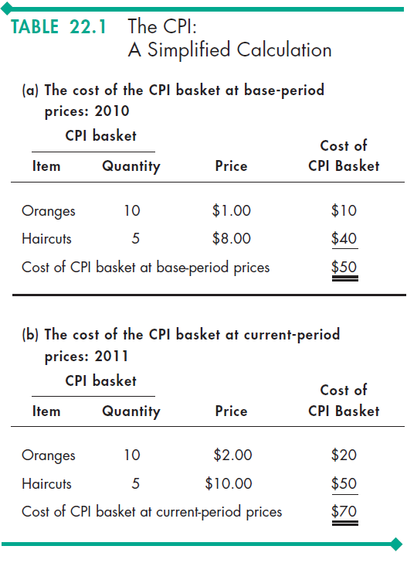
Stage 3: Calculating the CPI
Calculating the CPI To calculate the CPI, we
1. Find the cost of the CPI basket at base-period prices.
2. Find the cost of the CPI basket at current period prices.
3. Calculate the CPI for the base period and the current period.
The Formula for CPI is-
CPI= (Cost of CPI basket at current prices/ Cost of CPI basket at base-period prices)*100
Question: What is the CPI for 2010? What is the CPI for 2011?

Slide 8
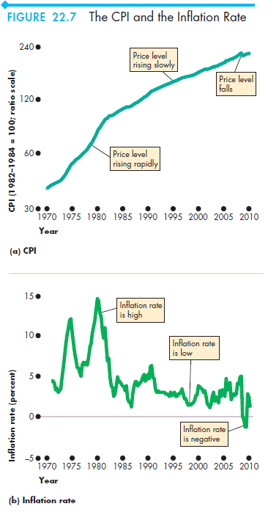
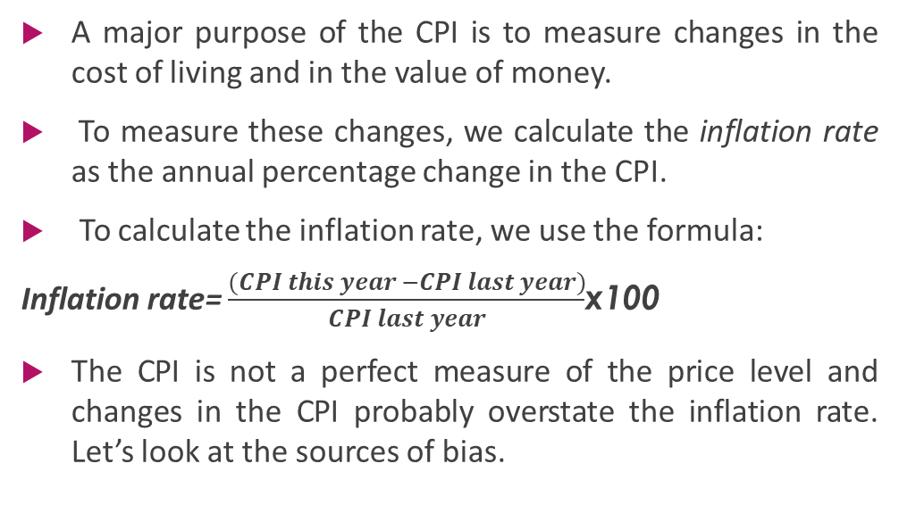
Measuring the Inflation Rate
A major purpose of the CPI is to measure changes in the cost of living and in the value of money.
To measure these changes, we calculate the inflation rate as the annual percentage change in the CPI.
To calculate the inflation rate, we use the formula:
Inflation rate= $\frac{(CPI this year −CPI last year)}{CPI last year}$x100
The CPI is not a perfect measure of the price level and changes in the CPI probably overstate the inflation rate. Let’s look at the sources of bias.

Slide 9
The Biased CPI
The main sources of bias in the CPI are:
■ New goods bias : The arrival of new technologies put an upward bias into the CPI and its inflation rate.
■ Quality change bias : Part of the rise in the prices of these items is a payment for improved quality and is not inflation. But the CPI counts the entire price rise as inflation and so overstates inflation.
■ Commodity substitution bias : Changes in relative prices lead consumers to change the items they buy.
■ Outlet substitution bias: When confronted with higher prices, people use discount stores more frequently and convenience stores less frequently. This phenomenon is called outlet substitution. The CPI surveys do not monitor outlet substitutions.

Slide 10
Alternative Price Index: The GDP Deflator
The CPI is just one of many alternative price level index numbers and because of the bias in the CPI, other measures are used for some purposes.
The GDP deflator is an index of the prices of all the items in the GDP. So, the GDP deflator is an index of the prices of the items in consumption, investment, government expenditure, and net exports.
GDP deflator= (Nominal GDP/ Real GDP)*100
This broader price index is appropriate for macroeconomics because it is a comprehensive measure of the cost of the real GDP basket of goods and services.
We can adjust any nominal quantity or price variable for inflation by deflating it—by dividing it by the price level.

